Slide 2
Winter Share Appeal 2018
The Winter Share Appeal is an important way that our church community can support vulnerable people who are experiencing crisis.
Donations will help people who need emergency relief – your gifts will make a real difference and provide things such as food, clothing, medical help and crisis housing.
These services are often the first step to connecting people in crisis with other long-term support programs.
You will be helping people like Naomi…

Slide 3
Naomi didn’t know where to turn…
For more than two years Naomi juggled caring for her husband and her children, making it impossible for her to do any paid work to cover their debts or build for the future. In 2013, Naomi’s husband died.

Slide 4
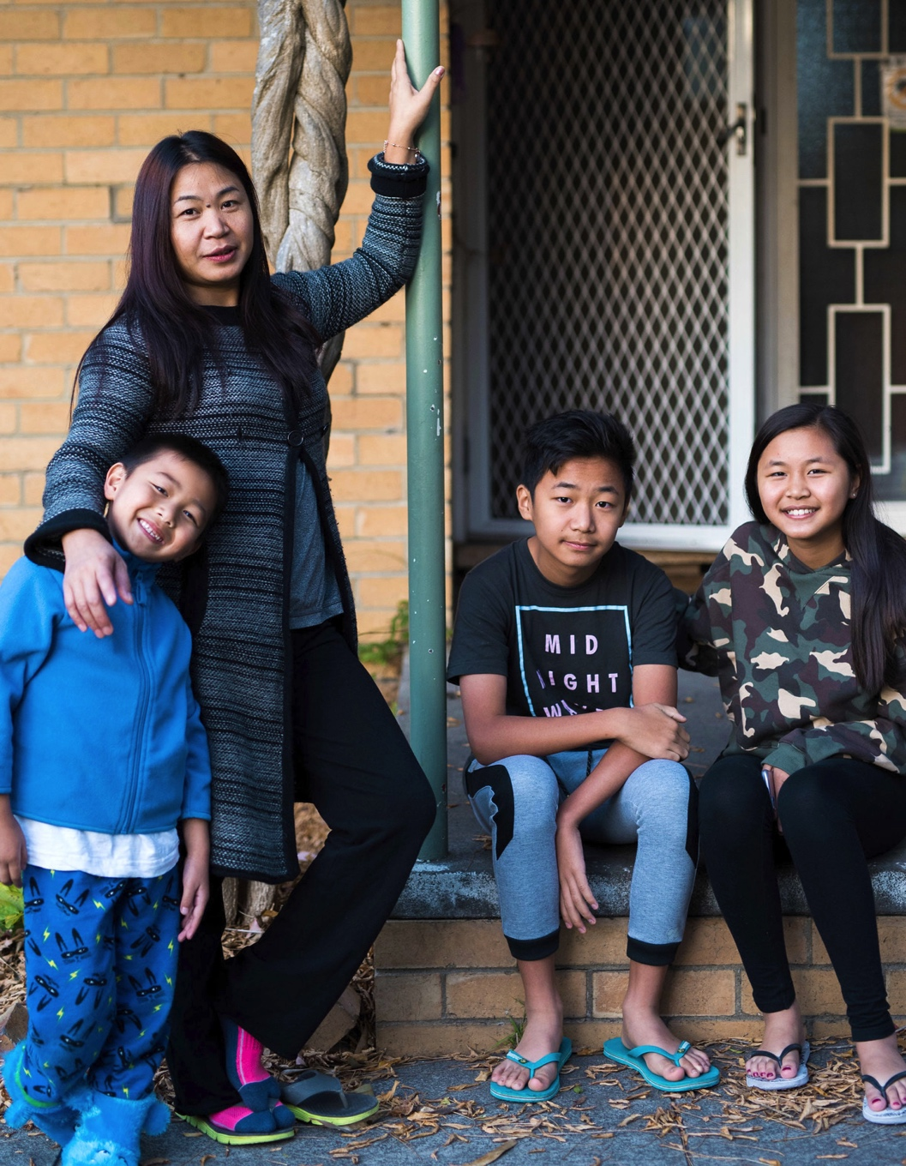
Naomi sat at the kitchen table staring at the eviction notice, years of grief and struggle bearing down on her. She had three young children to look after, mounting debt, and she was exhausted. Naomi was desperate until a friend from church suggested she contact Uniting homelessness services.

Slide 5
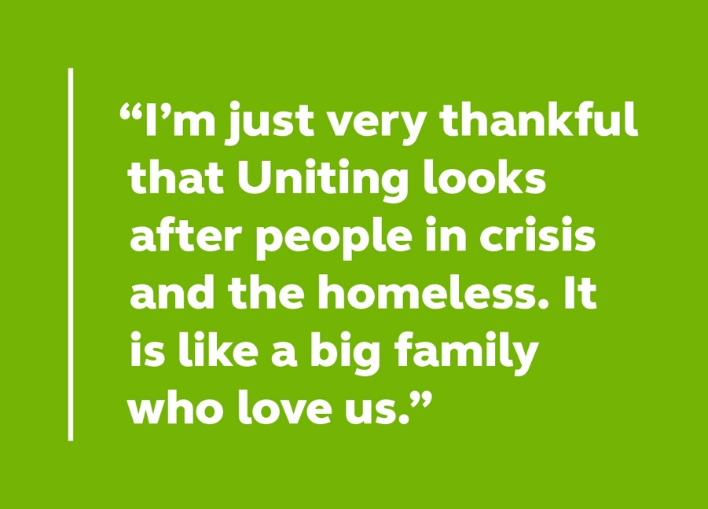
Increasing numbers of families in our community are doing it tough like Naomi. The cost of living is going up. Many people simply can’t afford to buy food or pay their bills. In the past three years requests for support from our key crisis and homelessness services have risen by 10% each year.

Slide 6
When Uniting works in collaboration with local congregations, sharing our resources, we make a huge difference for people in need. Together as a church community we provide a safety net for people such as Naomi who are doing their best to provide for their families.
Your donation today will immediately support people like Naomi who turn to us when they are in crisis.

Slide 7
How your gift will help
Your donation will provide emergency relief to people in need
Crisis accommodation: Uniting services help people find immediate crisis accommodation, along with medium-term homes while they stabilise their situation.
Material support: This can include food parcels/vouchers, community lunches/breakfast, mobile phone cards and petrol and travel vouchers.
Financial support: This is tailored to each unique situation.
It can include support for reading glasses, dental work, clothing and shoes, removalist costs, medical equipment or costs, rent, and children’s educational needs such as uniforms, school shoes, school camps and so on.

Slide 8
How your gift will help
Moving from crisis to stability
Emergency relief programs are often the first step to connecting vulnerable people in crisis with many other Uniting programs that can move them from crisis to stability.
As one of the largest community services organisations in Victoria and Tasmania, Uniting can ensure that a personalised and caring response can reach more people and make a huge difference.
Support is offered without judgment to people in the hope of enabling them and their families to engage in a safe and secure pathway to a stable life.
Your donation catches people in crisis and connects them with support that will move them from crisis to stability.

